Slide 1
Important Note Regarding This Microsoft PowerPoint Presentation
* Do not include this slide in your presentation *
This slide deck has been intentionally provided with very limited graphics and formatting to simplify content integration into your own preferred PowerPoint themes and styles.

Slide 2
Security Development Lifecycle (SDL) Training
Secure Design Principles (Level 100)

Slide 3
Agenda
Microsoft SDL and Secure Design
Secure Design Principles

Slide 4

Microsoft Security Development Lifecycle (SDL)
Training
Requirem-ents
Design
Implemen-tation
Verification
Release
Response
Delivering secure software requires:
Executive commitment → SDL a mandatory policy at Microsoft since 2004
Education
Technology and Process
Accountability
Ongoing Process Improvements → 6 month cycle

Slide 5
SDL Secure Design Principles
Safer applications begin with secure design
Core SDL secure design principles:
Attack Surface Reduction
Basic Privacy
Threat Modeling
Defense in Depth
Least Privilege
Secure Defaults

Slide 6
SDL Core Principle: Attack Surface Reduction
Attack Surface: Any part of an application that is accessible by a human or another program
Each one of these can be potentially exploited by a malicious user
Attack Surface Reduction: Minimize the number of exposed attack surface points a malicious user can discover and attempt to exploit

Slide 7

Attack Surface Example

Slide 8
Attack Surface Analysis
Step 1: Look at Your Entry Points
Step 2: Rank Your Entry Points
Network inputs/outputs
File inputs/ outputs
Etc.
Authenticated or non-authenticated
Administrative or user-level access
Network or local
UDP or TCP
Etc.

Slide 9
Attack Surface Analysis Tips
Iterative process, for all features you need to also analyze their sub-features
Restrict access to features as much as possible
File Format
.gif
.tiff
Protocols
SSLv2
SSLv3
.jpg
TLS
PCTS
Classic
WebDav
PROPPATCH, PROPFIND, DELETE, MOVE, LOCK
GET, POST, HEAD, OPTIONS, TRACE
HTTP Verbs
SMTP
HELO
EHLO
RCPT

Slide 10
It’s Not Just About Turning Things Off
Higher Attack Surface | Lower Attack Surface
On by default | Off by default
Open socket | Closed socket
UDP | TCP
Anonymous access | Authenticated user access
Constantly on | On as needed
Administrative access | User access
Internet accessible | Local subnet accessible
Running as SYSTEM | Running as user, network service or local service account
Uniform defaults | User defined settings
Large code | Small code
Weak access controls | Strong access controls

Slide 11
Attack Surface Reduction Examples
Microsoft Product | Attack Surface Reduction
Windows | Authenticated Remote Procedure Call (RPC) Firewall on by default
Internet Information Services 6.0 and 7.0 | Off by default Running as network service by default Static files by default
SQL Server 2005 and 2008 | xp_cmdshell stored procedure off by default CLR and COM off by default Remote connections off by default
Visual Studio 2005 and 2008 | Web server localhost only SQL Server Express localhost only

Slide 12
SDL Core Principle: Basic Privacy
Privacy versus Security
Privacy: Empowering users to control the use, collection and distribution of their personal information
Security: Establishing protective measures that defend against hostile acts or influences and protects the confidentiality of personal information
Privacy AND Security together are key factors for building trusted applications
Privacy
Security

Slide 13
Important Note: Security Does Not Always Guarantee Privacy
It is possible to have a secure system that does not preserve users’ privacy.

Slide 14
Primary Objectives When Developing Privacy-Aware Applications
Three primary objectives:
Fulfill legal obligations;
Increase customer trust; and
Prevent blocked deployments.

Slide 15
Understanding Application Behaviors and Concerns
Application Behavior | Privacy Concern
Target children | Children Online Privacy Protection Act (COPPA)
Transfer sensitive PII | Gramm-Leach-Bliley Act (GLBA), Health Insurance Portability and Accountability Act (HIPAA)
Transfer non-sensitive PII | European Union (EU) or Federal Trade Commission (FTC)
Modify system | Computer Fraud and Abuse Act (CFAA)
Continuous monitoring | Anti-Spyware Legislation, Deployment Blocker
Anonymous transfer | Deployment Blocker

Slide 16
Microsoft Privacy Guidelines for Developing Products and Services
Documented requirements and recommendations for privacy-compliant products and services
Available online for download
Microsoft customers will be empowered to control the collection, use, and distribution of their personal information

Slide 17
SDL Core Principle: Threat Modeling
Threat Modeling: A process to understand threats to an application
Threats and vulnerabilities are not the same thing:
Threats: What a malicious user may attempt in order to compromise a system
Vulnerabilities: A specific way a threat is exploitable, such as a coding error

Slide 18
Threat Modeling In a Nutshell
Vision
Model
Identify Threats
Mitigate
Validate
Product
Development

Slide 19
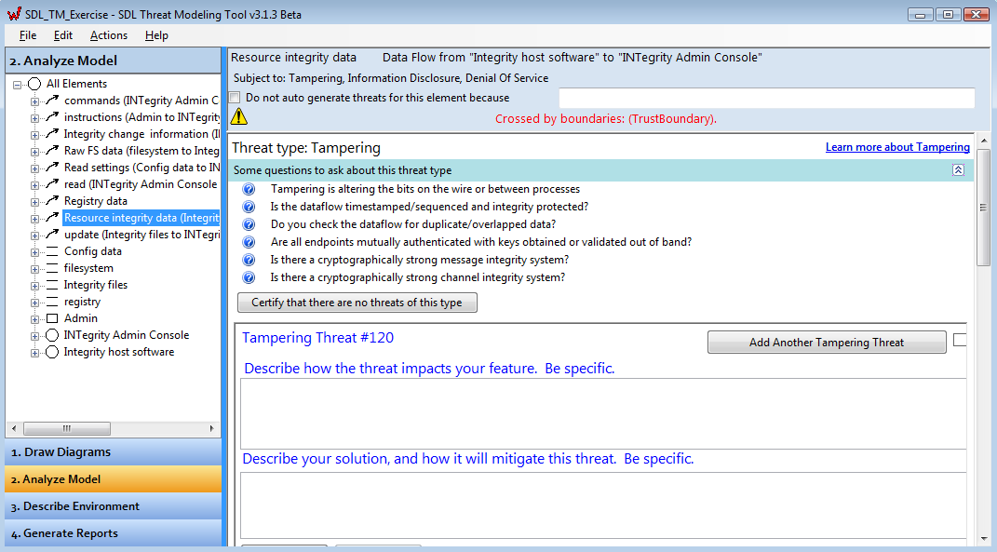
Microsoft SDL Threat Modeling Tool
Microsoft has published the threat modeling tool it uses internally to assess threats against products and services
Freely available online for download at http://msdn.microsoft.com/en-us/security/dd206731.aspx

Slide 20
SDL Core Principle: Defense In Depth
Assume that software and hardware will fail at some point
Trusted applications: security and privacy features and mechanisms
Most applications today can be compromised when single, and often only, layer of defense is breached (firewall)
Defense in Depth: If one defense layer is breached, what other defense layers (if any) provide additional protection to the application?

Slide 21

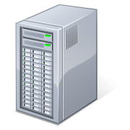

Defense in Depth Example

Slide 22
SDL Core Principle: Least Privilege
Assume that all applications can and will be compromised
Least Privilege: If an application is compromised, then the potential damage that the malicious person can inflict is contained and minimized accordingly

Slide 23

Least Privilege Example
LOCAL SYSTEM
NON-ADMIN
ADMIN / SYSTEM LEVEL
Read user files
Change system passwords
Download malicious files
Anything
NON-ADMIN
Read user files
Change system passwords
Download malicious files
Limited capabilities

Slide 24
Least Privilege Tips
Evaluate your application and think minimally!
What is the minimum access level your application requires to perform its functions?
Elevate privileges only when needed, and then release those elevated privileges when their purposes have been satisfied

Slide 25
SDL Core Principle: Secure Defaults
Secure Defaults: Deploy applications in more secure configurations by default.
Helps to better ensure that customers get safer experience with your application out of the box, not after extensive configuration
It is up to the user to reduce security and privacy levels

Slide 26
Secure Defaults Examples
Application Component | Secure Defaults Principle
Firewall | Firewall ON by default
SSL Socket | Requires last latest SSL version (v3, TLS, etc.) by default
User can access application anonymous or authenticated | Application requires authenticated user sessions by default
Password complexity can be enforced | Password complexity is required by default
Store user passwords as hashes or clear text | Store user passwords as hashes by default

Slide 27
Conclusion
Microsoft SDL and Secure Design
SDL Core principles:
Attack Surface Reduction
Basic Privacy
Threat Modeling
Defense in Depth
Least Privilege
Secure Defaults

Slide 28
Appendix

Slide 29


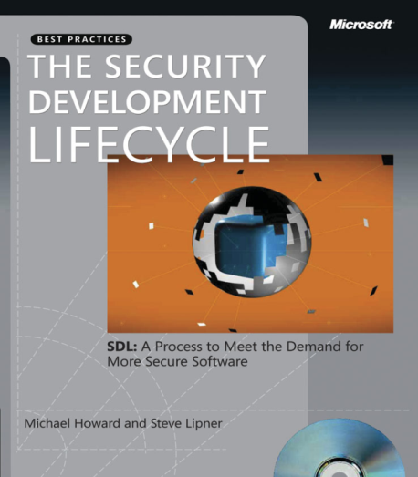


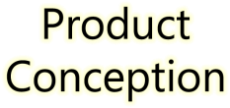
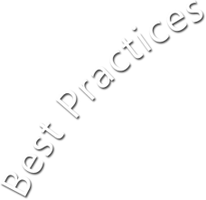














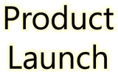





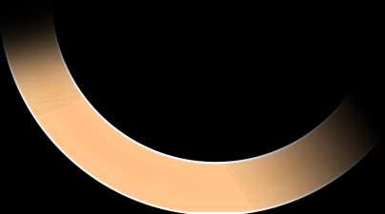

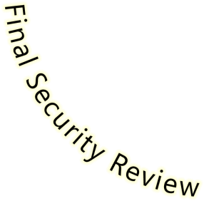








Microsoft Security Development Lifecycle (SDL)
SDL Book:
http://www.microsoft.com/mspress/books/8753.aspx
Official SDL Web Site: http://www.microsoft.com/sdl

Slide 30
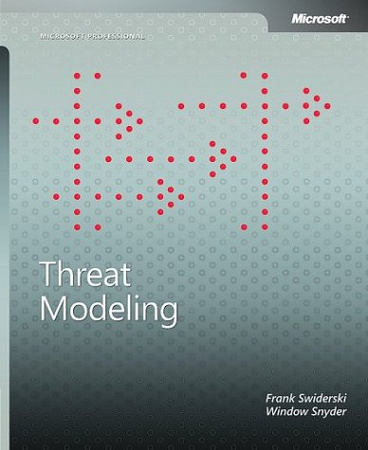
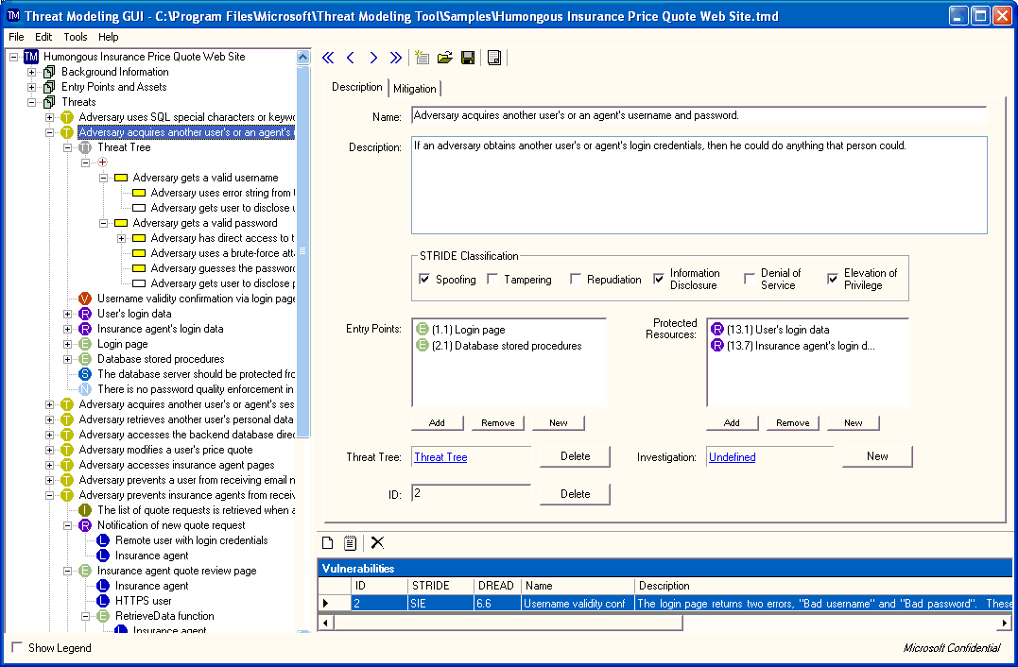
Threat Modeling Resources
Threat Modeling Book:
http://www.microsoft.com/mspress/books/6892.aspx
Threat Modeling Tool:
http://www.microsoft.com/downloads/details.aspx?FamilyID=62830f95-0e61-4f87-88a6-e7c663444ac1&displaylang=en

Slide 31
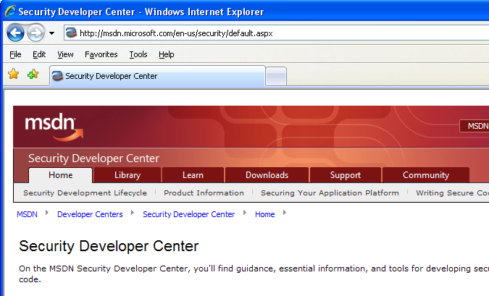

Microsoft Developer Network (MSDN) Security Developer Center
Official Web site: http://msdn.microsoft.com/security

Slide 32
Secure Development Blogs
The Microsoft Security Development Lifecycle (SDL) Blog: http://blogs.msdn.com/sdl
Michael Howard’s Blog: http://blogs.msdn.com/michael_howard

